Slide 1
MIDI Bass Guitar
A Project Presented By: Owen Fujii

Slide 2
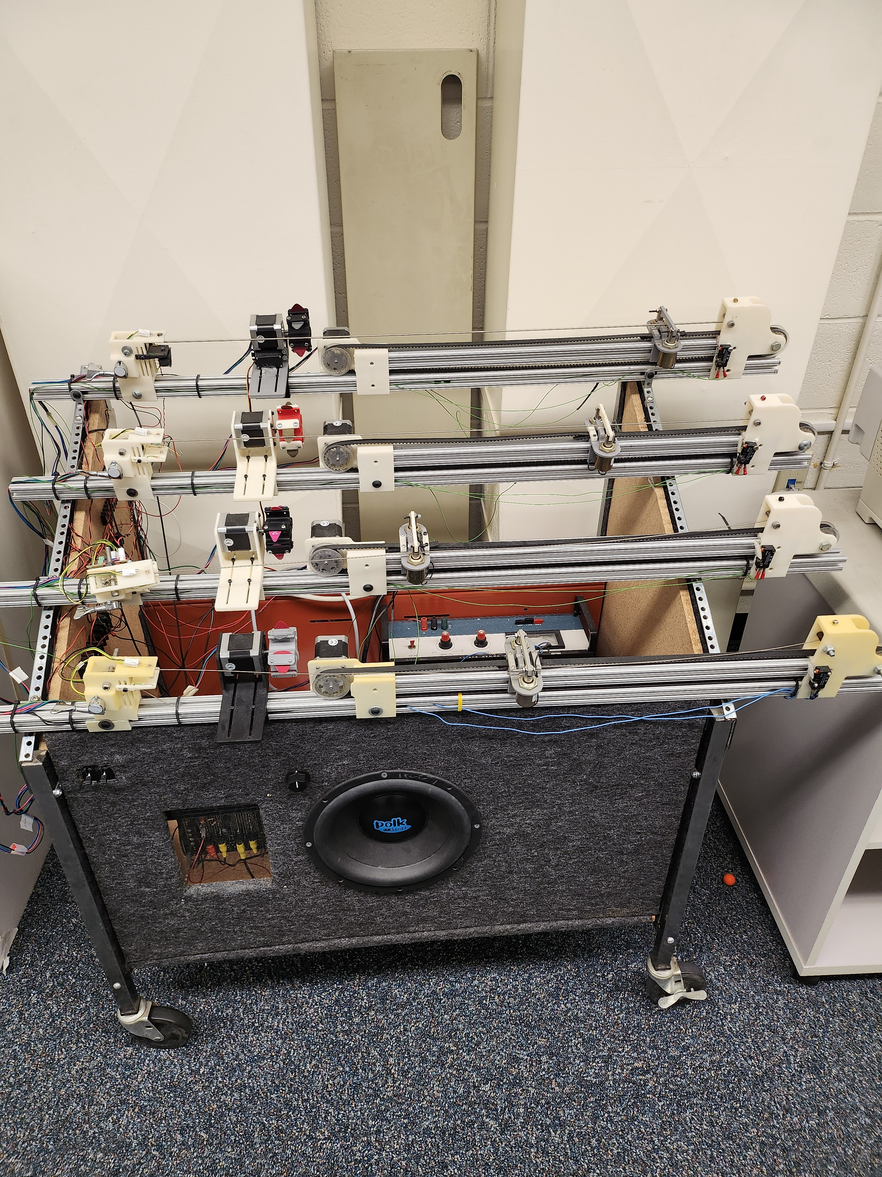
Prior Project

Slide 3
Project Goals
Design a Robotic Bass guitar that is controlled by MIDI
Bass closely sounds like a human player
Intuitive controls and function

Slide 4
Semester Goals
Develop firmware for bass guitar
Develop schematic for project
Begin planning mechanical platform

Slide 5
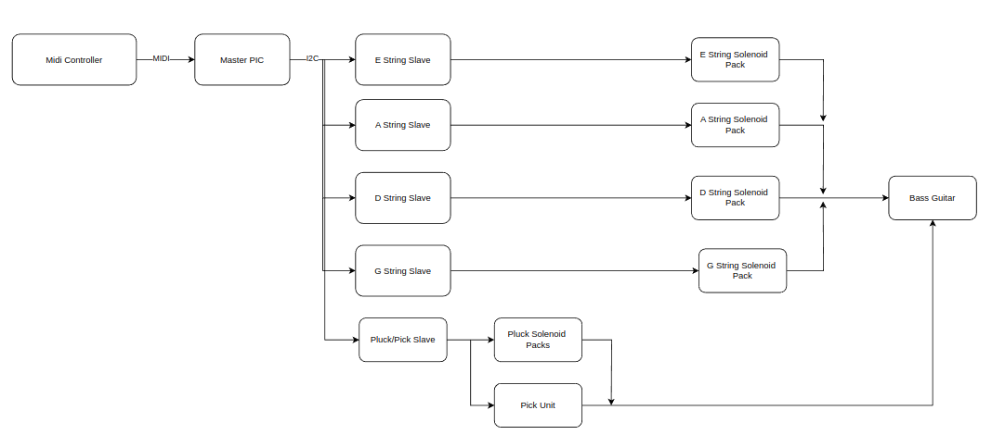
System Diagram

Slide 7
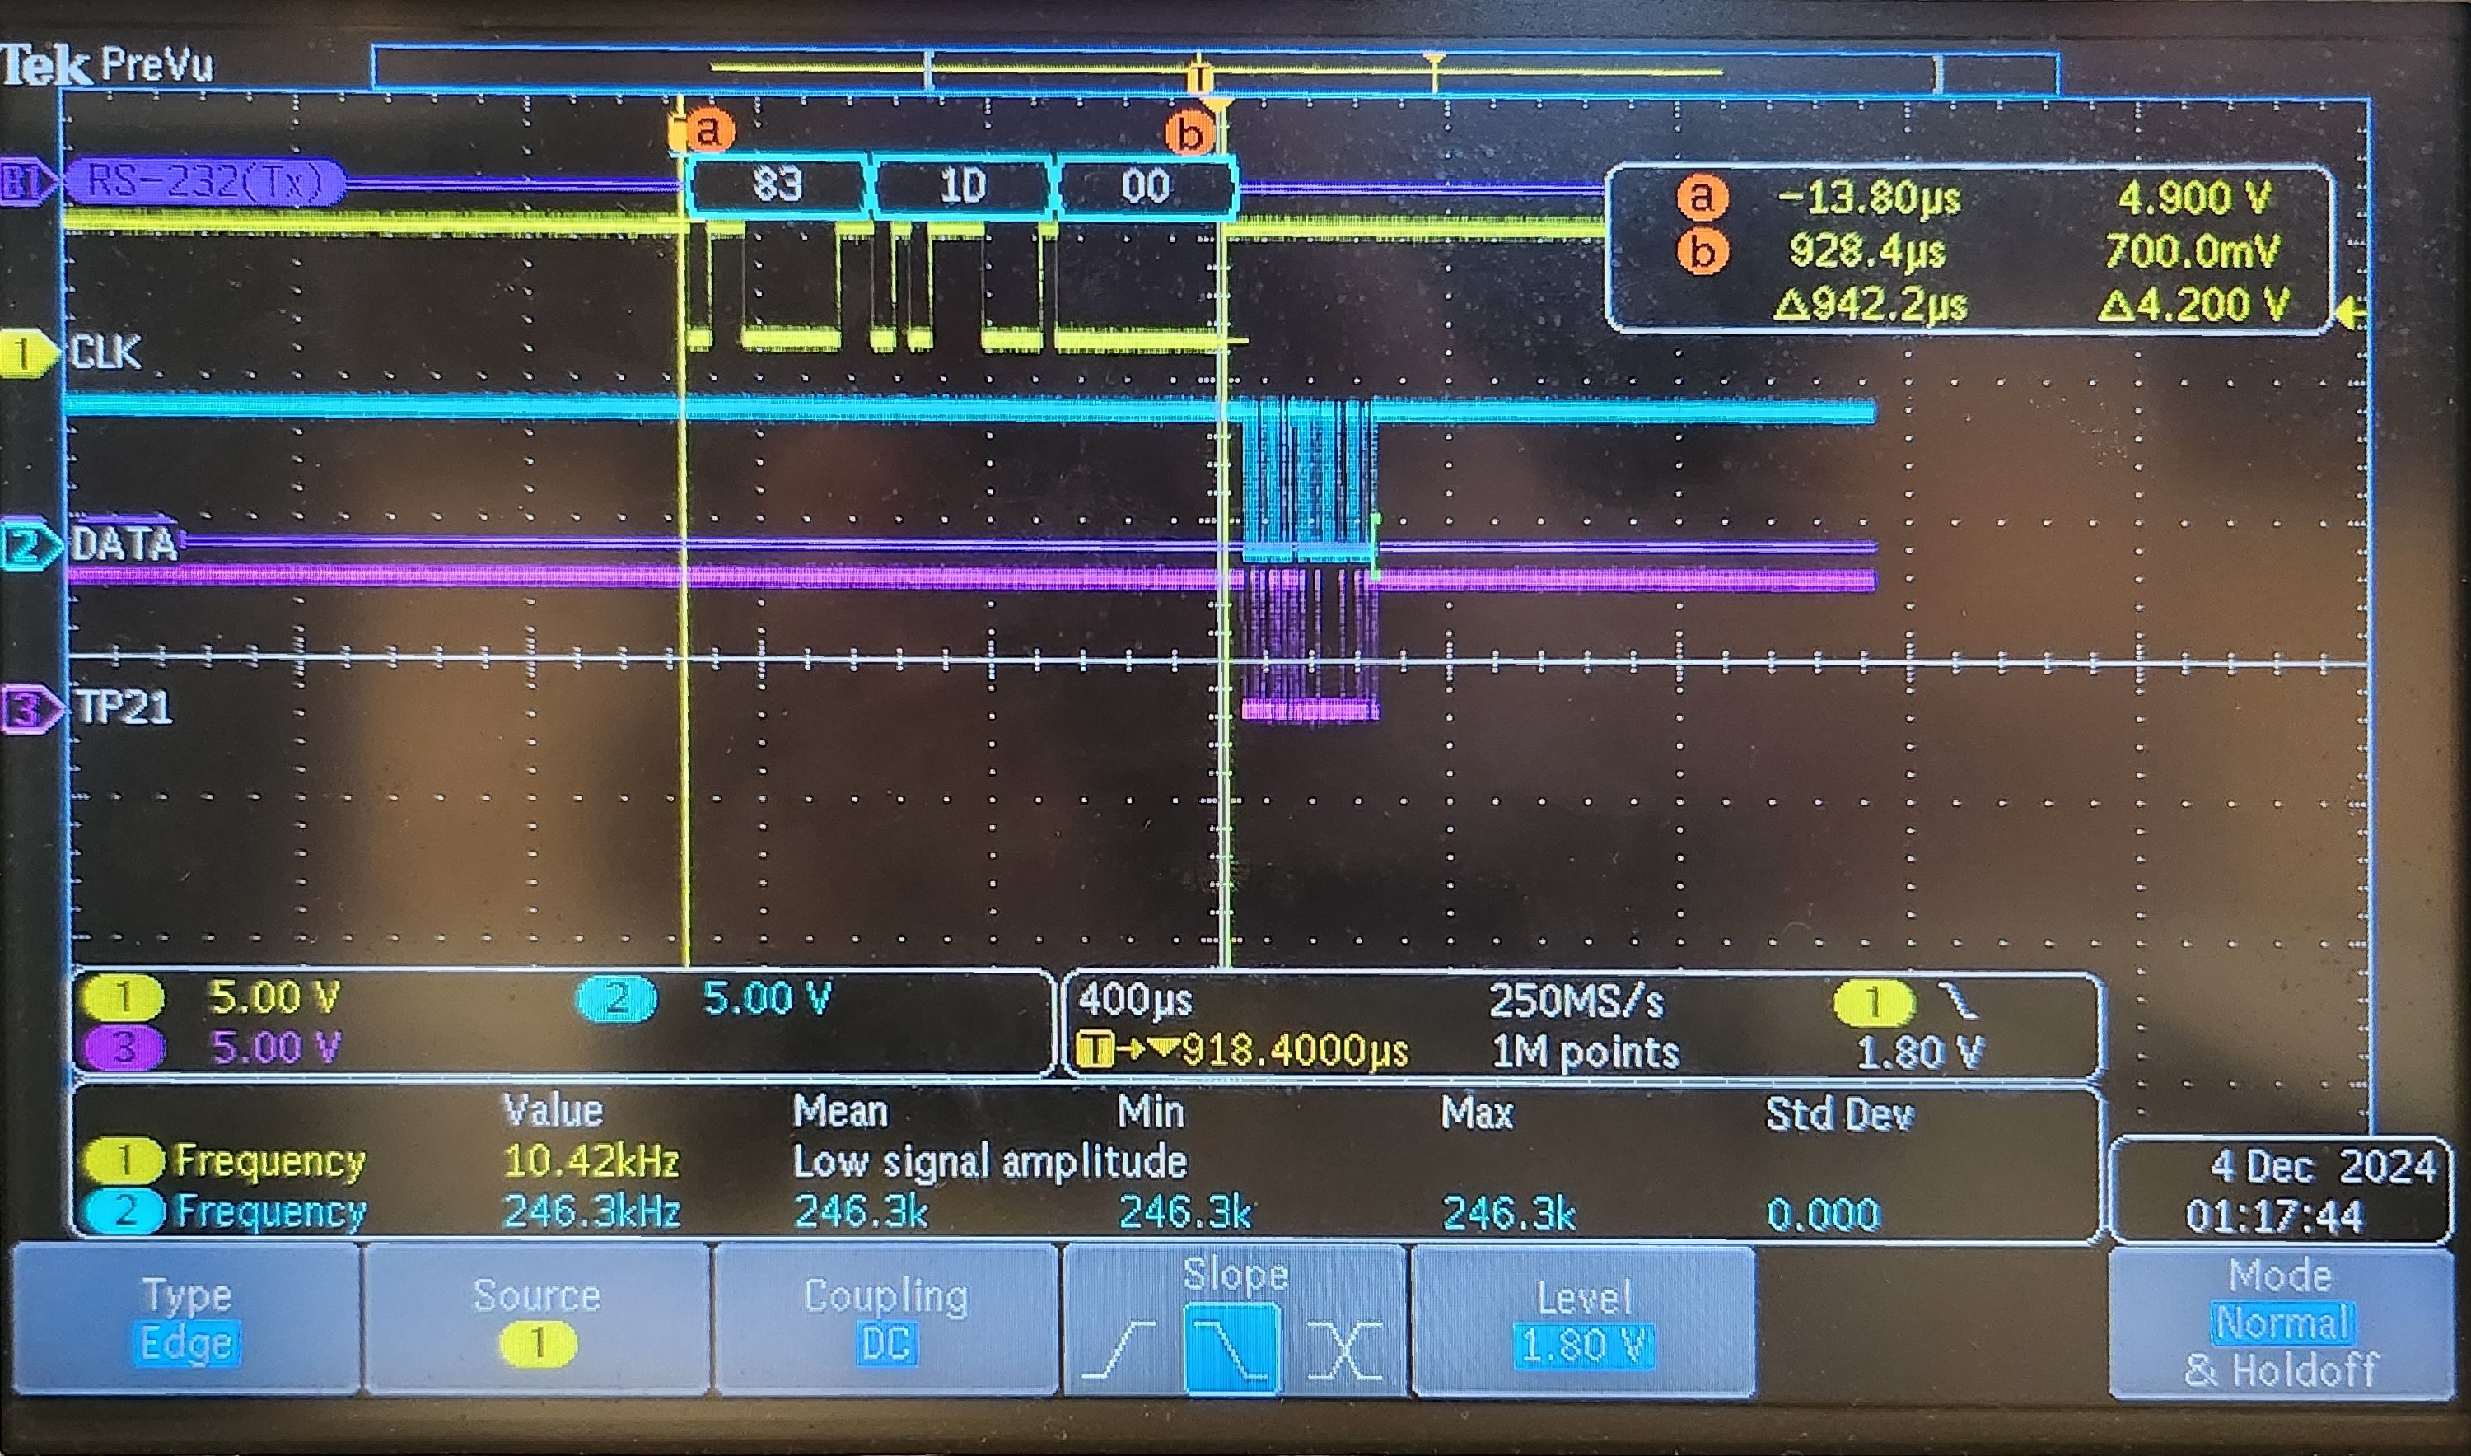
MIDI Received

Slide 8
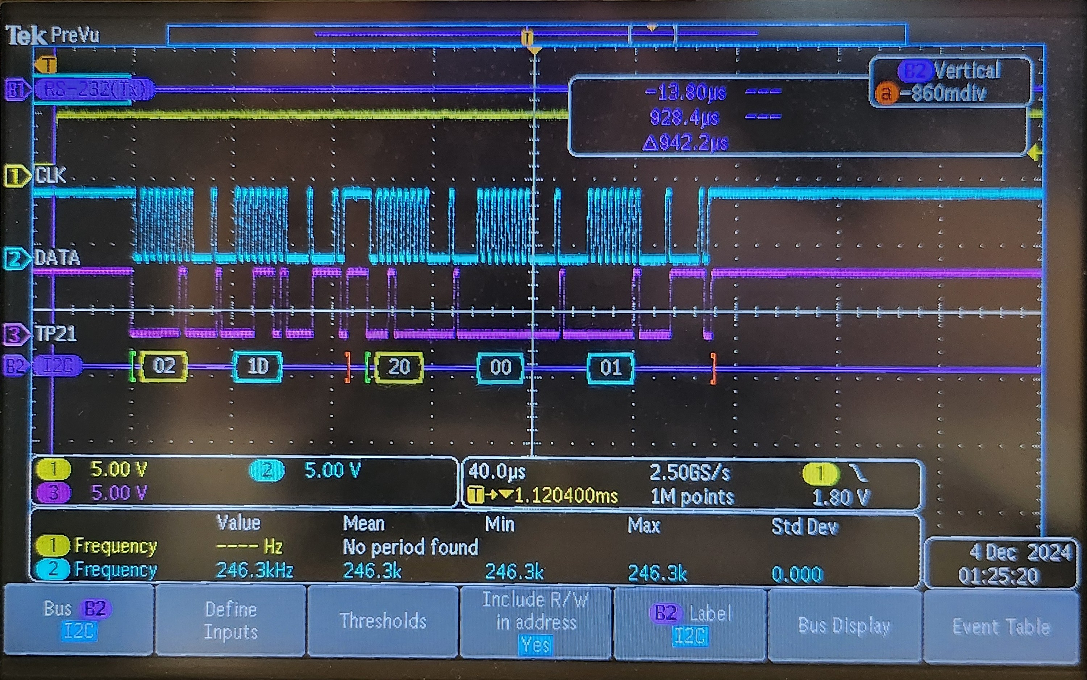
I2C Protocol

